Slide 1
Relational Data Storage
CS4981 ML Production Systems
RJ Nowling

Slide 2
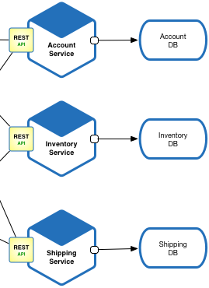
Database-backed Services
Source: https://microservices.io/patterns/microservices.html

Slide 3
Relational Database Management Systems
IBM DB2^{P}
Microsoft SQL Server^{P}
MySQLOS / MariaDB^{OS}
Oracle SQL Server^{P}
PostgreSQLOS
P: proprietary, OS: open-source

Slide 4
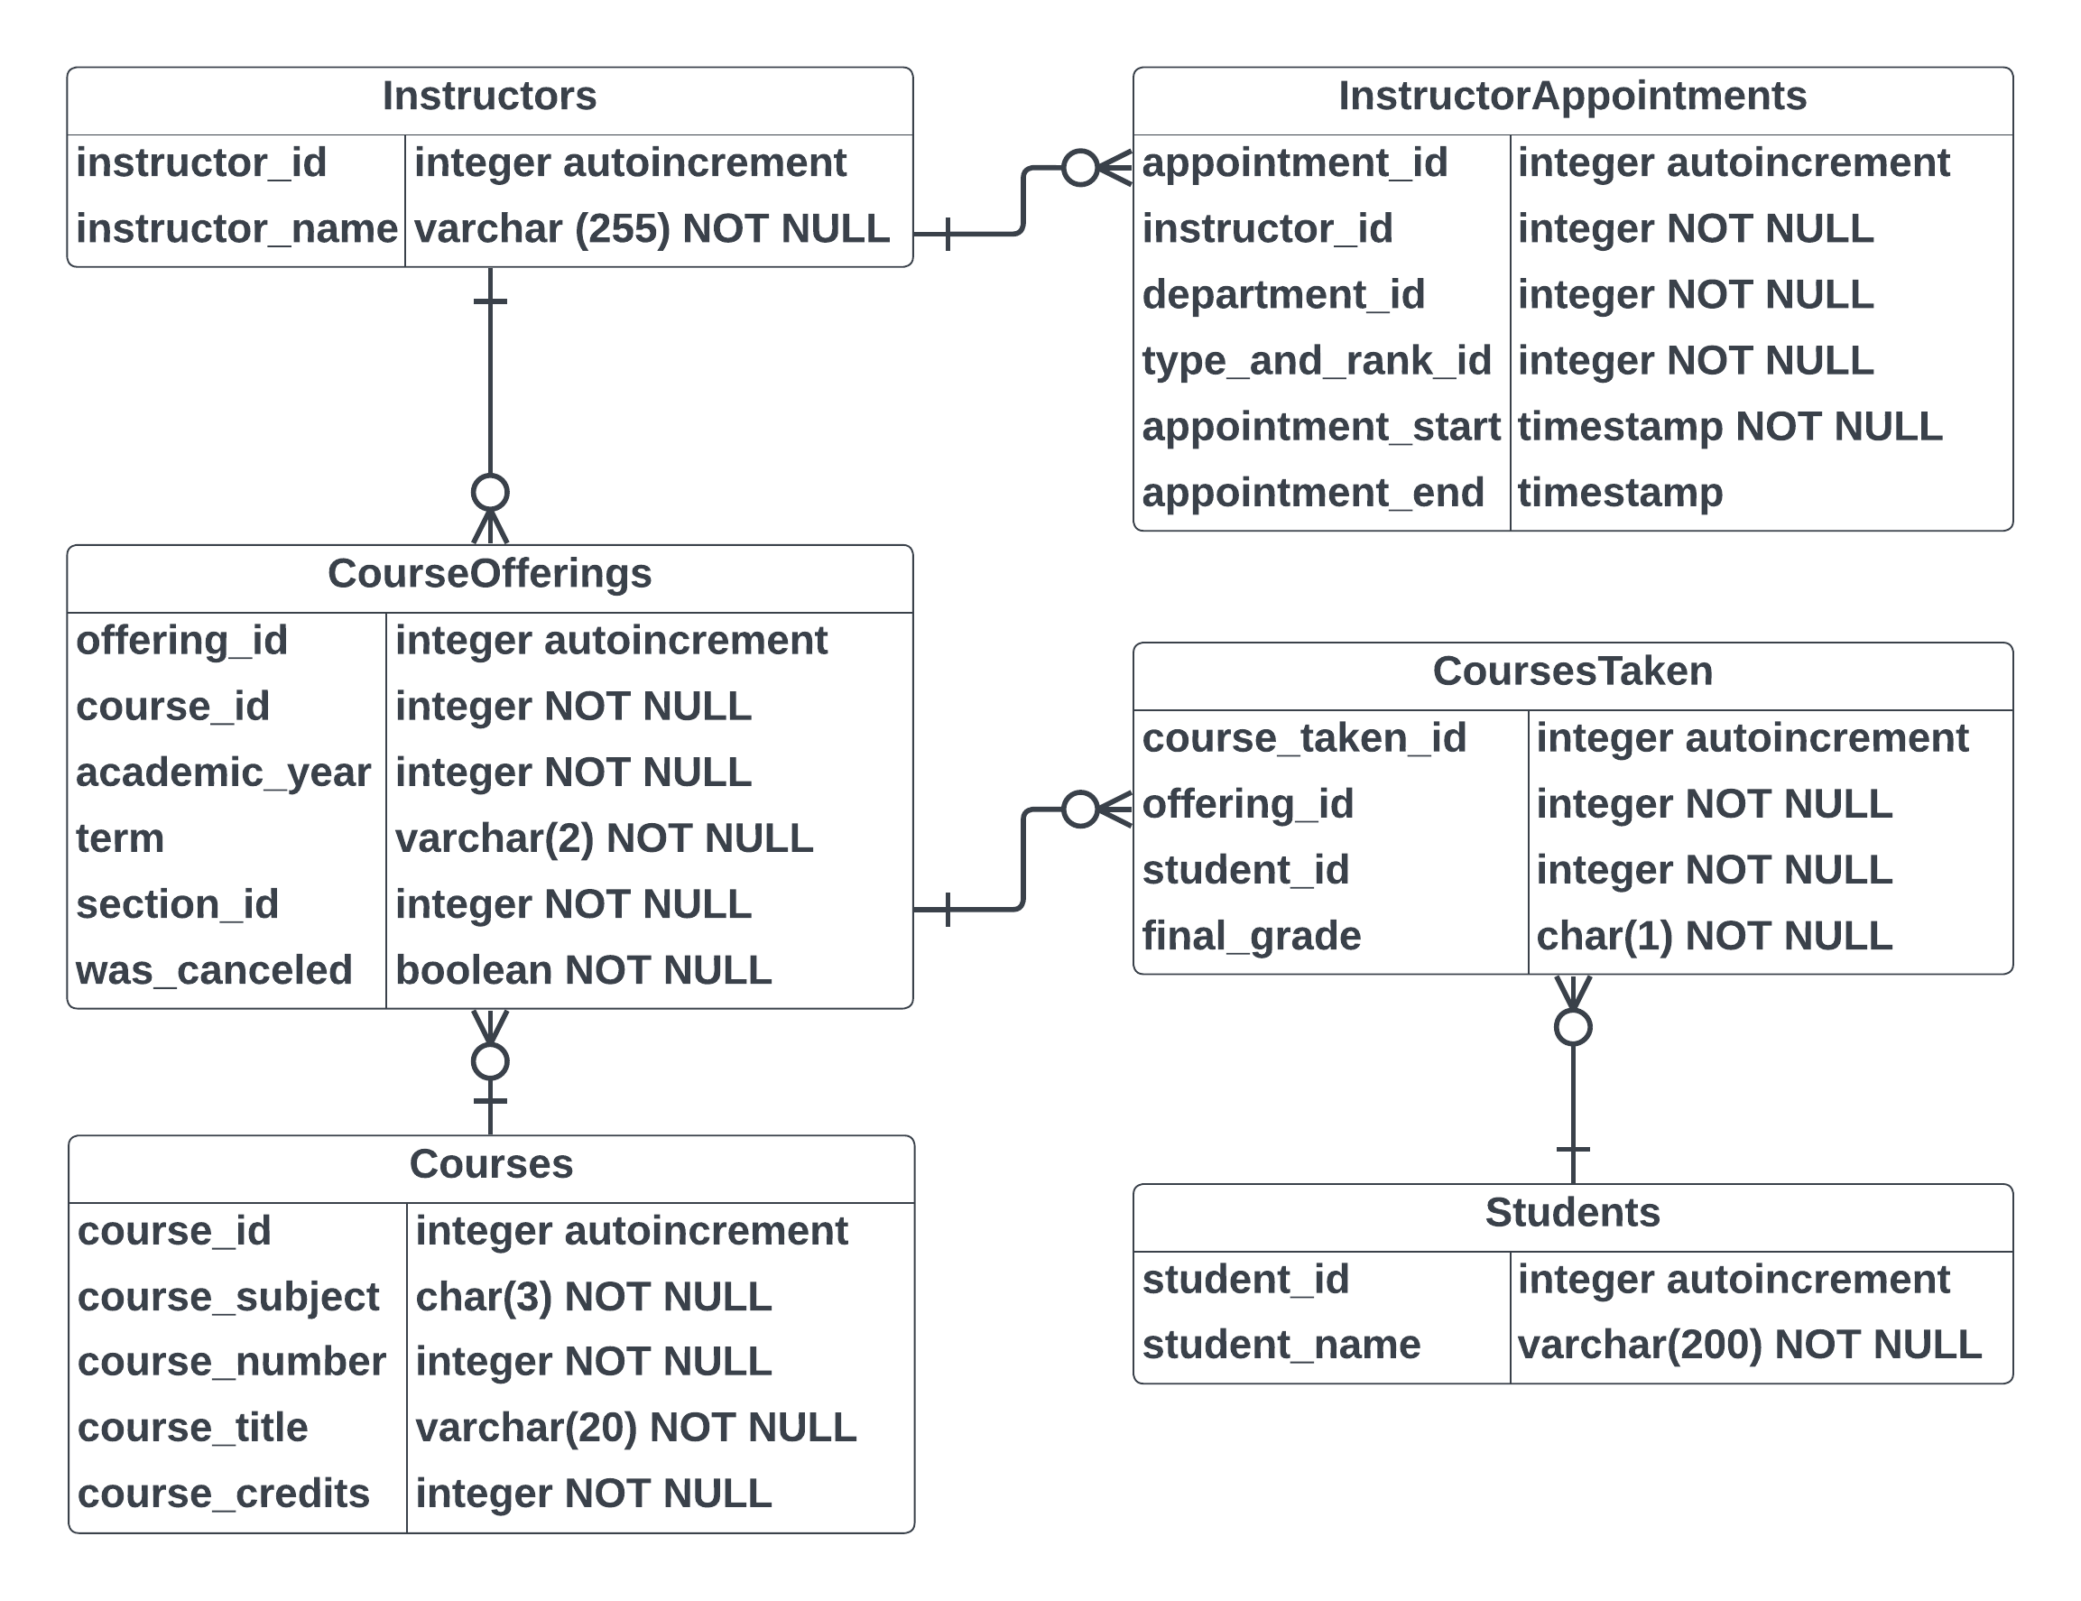
Data Model

Slide 5
Course Table Example
course_id | course_subject | course_number | course_title | course_credits
1 | MA | 136 | Calculus I | 4
5 | MA | 137 | Calculus II | 4
11 | MA | 262 | Probability and Statistics | 3
23 | CS | 1011 | Software Development I | 4
24 | CS | 1021 | Software Development II | 4
25 | CS | 2852 | Data Structures | 4
56 | HU | 432 | Ethics | 3
416 | EC | 121 | Microeconomics | 3
1025 | EC | 122 | Macroeconomics | 3

Slide 6
Common Column Types
Boolean
Character
Dates / times / intervals
Enumerations (categorical)
Integers
Reals (floats, doubles)
Text (char, varchar)
The supported types are relatively simple
But they can be combined to represent complex, compound data types

Slide 7
Enforces Schema
A type is specified for each column
A record is only allowed to be added or changed if it conforms to the schema
Ensures that data are consistently typed and avoids errors
A program will be prevented from adding a record with the value 'ABC' for a course number because 'ABC' is not an integer

Slide 8
Relational Data Integrity
Record dependencies captured through foreign key constraints
Database maintains relational integrity
Cannot add a course offering if there is not associated course
Cannot delete an instructor if they have taught any courses

Slide 9
Enforces Schema
The schemas are not perfect, however.
A record with the value -25 for a course number will be accepted because it's an integer -- even though we only want positive numbers.
Validation logic must also be added to the program manipulating the database to ensure fine-grained details are correct.

Slide 10
Structured Query Language (SQL)
SELECT id, name
FROM customers
WHERE is_active = true
ORDER BY size DESC
LIMIT 10;
Structured Query Language (SQL) is relatively easy for technical and non-technical users to understand
Designed to resemble natural language to some extent

Slide 11
SQL Operations
SQL has six main verbs that statements can start with:
CREATE: creates a database or table
DELETE: delete records from a table
DROP: deletes a database or table
INSERT: append records to a table
SELECT: choose a subset of records from a table
UPDATE: modify the values in existing records

Slide 12
SQL Example
SELECT * FROM Courses WHERE course_subject = 'CS';
course_id | course_subject | course_number | course_title | course_credits
23 | CS | 1011 | Software Development I | 4
24 | CS | 1021 | Software Development II | 4
25 | CS | 2852 | Data Structures | 4

Slide 13
SQL Example
SELECT * FROM Courses WHERE course_subject = 'CS'
ORDER BY course_number DESC;
course_id | course_subject | course_number | course_title | course_credits
25 | CS | 2852 | Data Structures | 4
24 | CS | 1021 | Software Development II | 4
23 | CS | 1011 | Software Development I | 4

Slide 14
SQL Example
SELECT * FROM Courses WHERE course_subject = 'HU'
OR course_subject = 'EC';
course_id | course_subject | course_number | course_title | course_credits
56 | HU | 432 | Ethics | 3
416 | EC | 121 | Microeconomics | 3
1025 | EC | 122 | Macroeconomics | 3

Slide 15
SQL Example
SELECT * FROM Courses WHERE course_credits = 4;
course_id | course_subject | course_number | course_title | course_credits
1 | MA | 136 | Calculus I | 4
5 | MA | 137 | Calculus II | 4
23 | CS | 1011 | Software Development I | 4
24 | CS | 1021 | Software Development II | 4
25 | CS | 2852 | Data Structures | 4

Slide 16
Security
Support user accounts
When a program or user connects to the system, they must provide a username and password for authentication and authorization
Accounts can be selectively given select, insert, update, and/or delete permissions on a per-table basis
Some DBMSs support row-level permission policies
Limit access by programs or users to what is strictly necessary to perform their function

Slide 17
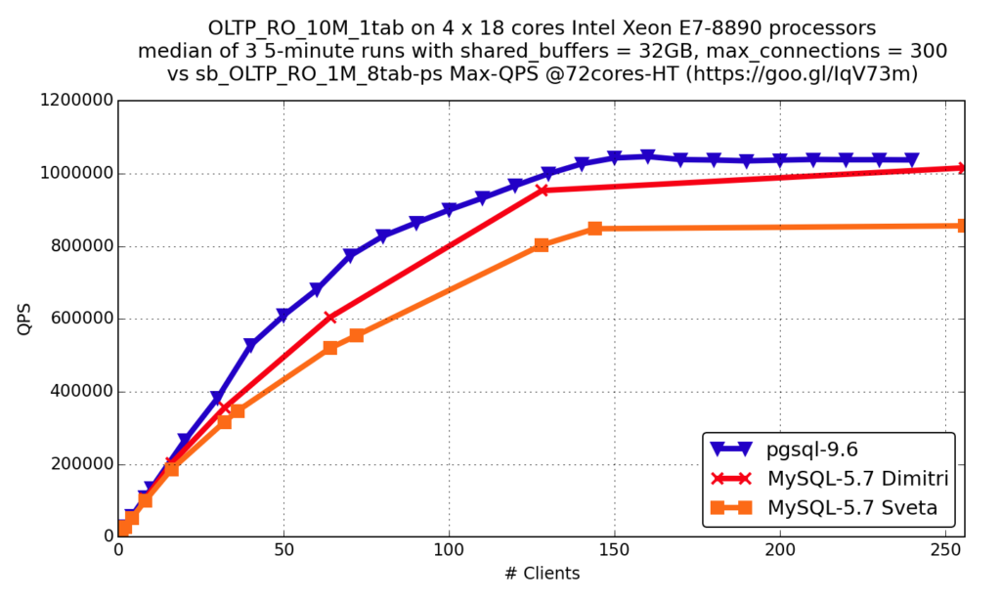
Parallelism (Connections)
Support many concurrent connections
Processing for each connection limited to using a single core
Number of connections scales linearly with the number of CPU cores
Source: https://www.percona.com/blog/millions-queries-per-second-postgresql-and-mysql-peaceful-battle-at-modern-demanding-workloads/

Slide 18
Parallelism (Large Queries)
Queries that operate on many rows and/or across multiple tables (e.g., joins) are often computationally expensive
These types of queries might be run by companies to get daily sales numbers
Many relational databases do not process individual queries using more than 1 - 4 cores
Limits scalability of queries within individual connections

Slide 19
Handles Concurrency Intuitively
Changes are executed in a consistent manner -- all or no users see change
Changes are tracked at the row level -- fine grained
If there is a conflict, the operation fails (atomic) and the application can retry
Pushes details of managing concurrency into the database, simplifying application development

Slide 20
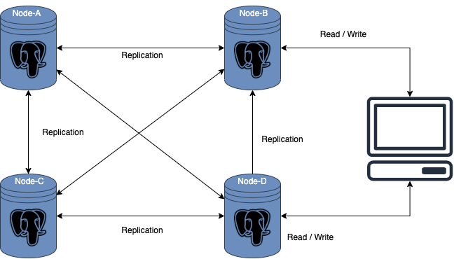
Clustering
Relational databases can be "clustered" -- multiple physical servers participate in the same logical server
The primary use case is reliability -- if a single physical server fails, another can take over
Each server has its own replica of the data
Source: https://www.percona.com/blog/multi-master-replication-solutions-for-postgresql/

Slide 21
Read / Write Parallelism
Most clustered relational databases use a single a small number of primary servers that can handle writes
The other servers receive updates and can only serve read requests
Limits writes but can scale reads
Source: https://www.percona.com/blog/multi-master-replication-solutions-for-postgresql/

Slide 22
Distributed Data?
Many relational databases do not support distributed data
Meaning, data sets are not divided across servers
Limits data sizes to the capabilities of a single physical server
Source: https://www.percona.com/blog/multi-master-replication-solutions-for-postgresql/

Slide 23
Relational Data Model != Implementation
The relational data model and SQL language are a logical abstraction
They do not specify a physical implementation
Do not require Atomicity, Consistency, Isolation, Durability (ACID) semantics
Different implementations can make different tradeoffs

Slide 24

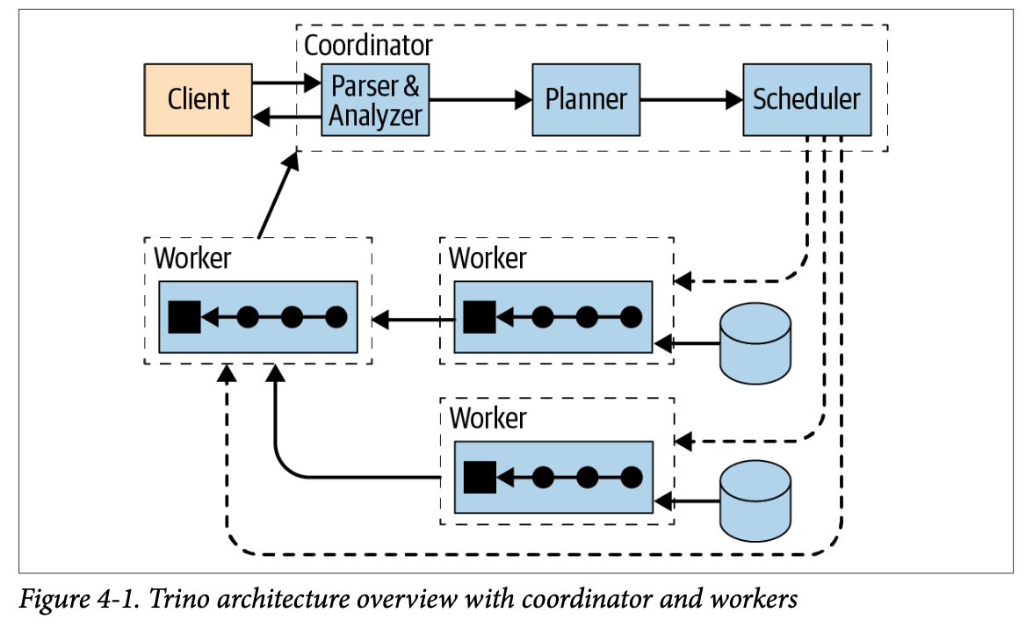
PrestoDB / Trino
Distributed query engine
Doesn't store data itself -- loads data at query time
Handles distributed computing
Created in 2012 by Meta
Open sourced in 2013
Forked to created Trino in 2019
Matt Fuller, Manfred Moser, and Martin Traverso. Trino: The Definitive Guide. 2021.

Slide 25
PrestoDB / Trino
Each worker machine loads a subset of the data from external sources at query time
Queries computation are spread across workers
Scheduler handles movement of data
Results returned to client
Matt Fuller, Manfred Moser, and Martin Traverso. Trino: The Definitive Guide. 2021.

Slide 26
Data Virtualization
Supports multiple data sources:
Other relational databases
Files in HDFS
Files in object stores
MongoDB
Redis
Presents a unified view of data as SQL tables
Single abstraction for querying and integrating data
Matt Fuller, Manfred Moser, and Martin Traverso. Trino: The Definitive Guide. 2021.

Slide 27
Limited Write Capability
Presto can generate new tables
Updates are dependent on the underlying data source
E.g., tables stored as objects in AWS S3 cannot be updates
but tables stored in Postgres can be -- but inherits the performance restrictions of Postgres
Matt Fuller, Manfred Moser, and Martin Traverso. Trino: The Definitive Guide. 2021.

Slide 28
Consistency
Presto does not ensure consistency across data sources
No ACID compliance
Not good for multiple users modifying data
Primary use case is analyzing data (read-only queries), not changing data
Matt Fuller, Manfred Moser, and Martin Traverso. Trino: The Definitive Guide. 2021.

Slide 29
Other Distributed Query Engines
Apache Flink (SQL component)
Apache Hive
Apache Drill
Apache Impala
Apache Kudu
Apache Spark (SQL component)
Citus Data

Slide 30
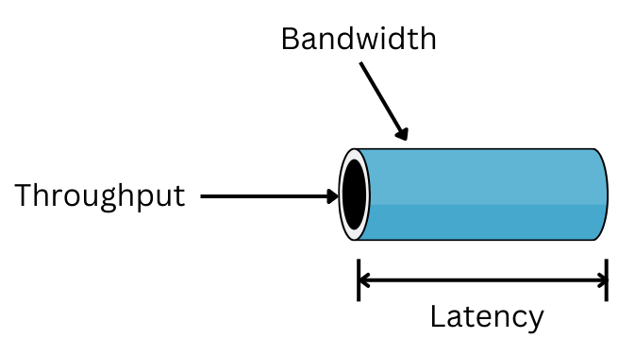
Tradeoffs: Throughput vs Latency
Latency: how quickly a request is processed
Throughput: how much data can be processed at once
Fundamental tradeoff: Many systems need to choose between
fine-grained data updates -> low latency / low throughput
coarse-grained data updates -> high throughput / high latency
Source: https://www.totalphase.com/blog/2022/09/how-does-latency-throughput-affect-speed-system/

Slide 31
Online Transactions Processing (OLTP)
Online Analytics Processing (OLAP)
Traditional RDBMS
Simpler queries
Many concurrent users
Optimized for combined fine-grained read and write workloads
Low latency / low throughput
NewSQL
More complex queries
Few concurrent users
Optimized for workloads reading large amounts of data
High throughput / high latency

